Slide 1
Text2Human: Text-Driven Controllable Human Image Generation
Author:
Yuming Jiang, Shuai Yang, Haonan Qiu, Wayne Wu, Chen Change Loy, Ziwei Liu
ACM Transactions on Graphics (TOG) - 2022
DOI: 10.1145/3528223.3530104
Long Pan
Notes:
Hi everyone, This is my video submission for real-time rendering assignment five.
In this assignment, I plan to implement a system by using some descriptive texts to generate corresponding 2D human images,
and then use these 2D human images to generate 3D human models.

Slide 2

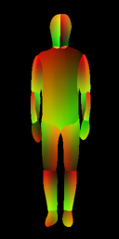
Implementation
Human Pose
A person standing with hands hanging down
Shape Text
A lady with a T-shirt and a skirt
Texture Text
Lady wears a short-sleeve T-shirt with pure color pattern, and a short and denim skirt.
Notes:
First part is text2human. Text2Human means you only need to provide some text descriptions of the shape and texture, as well as a desired human pose. The system can then generate a human image based on your input. For example, if you provide a human pose with a person standing with his hands hanging down, and you want to generate a lady wearing a short-sleeved T-shirt and a denim skirt, you can simply describe the shape and texture just like this.

Slide 3
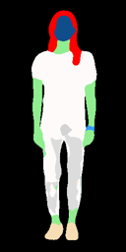

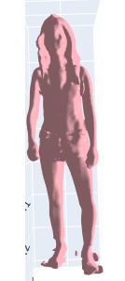
Implementation
Human pose
Human parsing
Human image
3D Model
Notes:
The generation process is divided into two parts. First, it generates a human parsing based on the provided human pose, as shown in this image. Then, it generates the texture based on the provided text descriptions. As you can see from the resulting image, there are some places that are slightly misplaced, but overall the output is not too bad.
However, I want to explore more possibilities based on these 2D images. I just thought can we generate 3D models just from 2D images? I did some research and found some theories that support my idea, and then I implemented that.

Slide 4
Implementation
Human pose
Human parsing
Human image
3D Model
Notes:
Just like this.

Slide 5
Theoretical background
SMPL (Skinned Multi-Person Linear Model)
SMPL is a linear algebra-based framework used to generate realistic human poses and shapes. It captures the body's skeletal structure and muscle form using anatomical knowledge and encodes this information into a mathematical model.
NeRF (Neural Radiance Fields)
NeRF is a method used to build realistic 3D scene models. It estimates the color and transparency of the scene at each pixel point based on ray tracing, predicts the color and transparency of each point in the scene generates a highly realistic 3D scene model.
Notes:
The first is SMPL, which stands for Skinned Multi-Person Linear Model. This is a framework used to generate realistic human poses and shapes. I can use it to capture the body's skeletal structure and muscle movements.
The next is NeRF, which is a method used to build realistic 3D models. It's an advanced rendering technique that estimates the color and transparency of each pixel point in a scene based on ray tracing, and generates a highly realistic 3D model based on this information.

Slide 6
Implementation process
Generate realistic 3D model from a 2D image:
Use SMPL to construct a 3D model of the human body using the contour or key point information of the 2D image as input
Use NeRF to generate a realistic 3D human body model by using the SMPL model as input.
Notes:
So based on these theories, if I want to generate a realistic 3D scene model from a 2D image containing a human body. I need to follow these steps:
First, using SMPL to construct a 3D model of the human body using the keypoint information of 2D images as input.
Then, using NeRF to generate a realistic 3D human body model by using the SMPL model as input.
Okay, let me demonstrate the code part.
These are all my presentation. Thank you for listening!

